Slide 1
Carbon Offsets for Compliance Under AB32
Joel Levin
Vice President of
Business Development

Slide 2
Background on the Climate Action Reserve
Chartered by state legislation in 2001
Mission is to encourage early voluntary actions to reduce emissions and to have such emissions reductions recognized
Initially focused on emission reporting and reductions by member organizations
Now on emission reduction projects generating offsets
Balances business, government, and environmental interests

Slide 3
Board of Directors
British Columbia Climate Action Secretariat, Ministry of Environment
California Environmental Protection Agency
Duke University
Environmental Defense Fund
Exelon Corporation and Federal Energy Regulatory Commission (Retired)
Metropolitan Water District of Southern California
National Institute of Ecology (INE), Mexico
Natural Resources Defense Council
New Resource Bank
NRG Energy
Sacramento Municipal Utility District
Shell Oil Company

Slide 4
Objectives of the Reserve
Encourage actions to reduce greenhouse gas emissions
Show that carbon offsets can be a useful tool in addressing climate change
Model an offset program that has environmental integrity but is not burdensome to use
Create value for the North American carbon market
Link the voluntary carbon markets with emerging compliance markets (CA, WCI, …)
Provide technical resources on offset standards and policy

Slide 5
What We Do
Develop High Quality Standards
Convene stakeholders and lead development of standardized protocols for carbon offset projects
Manage Independent Third Party Verification
Training and oversight of independent verification bodies
Operate a Transparent Registry System
Maintain registry of approved projects
Issue and track serialized credits generated by projects

Slide 6
What makes the Reserve different? Recognition
Recognized and Supported by:
California Air Resources Board
State of Pennsylvania
Voluntary Carbon Standard (VCS)
Leading environmental organizations:
Environment America
Natural Resources Defense Council (NRDC)
Environmental Defense Fund
Union of Concerned Scientists
Sierra Club
Wilderness Society

Slide 7
What makes the Reserve different? Transparency
Unparalleled transparency makes the Reserve unique
Public reports include:
All protocols and associated documents
List of all account-holders
List of all projects and all project documents
List of all issued CRTs for every project
All retired CRTs

Slide 8
What makes the Reserve different? Performance Standard
Why a performance standard is different
The hard work is upfront
Assess industry practice as a whole, rather than individual project activities
Less subjective determination to qualify
More certainty in amount of credits
Lower risk for developers and investors
Faster project processing

Slide 9
What makes the Reserve different? Separation of Roles
Is not affiliated with the State of California
Reserve does not fund or develop projects
Does not take ownership of offsets
Is not an exchange
Is a 501(c)3 not-for-profit organization
Independent third-party verification
Consistent with international standards
Accreditation done by ANSI
Assiduous oversight of verifiers

Slide 10
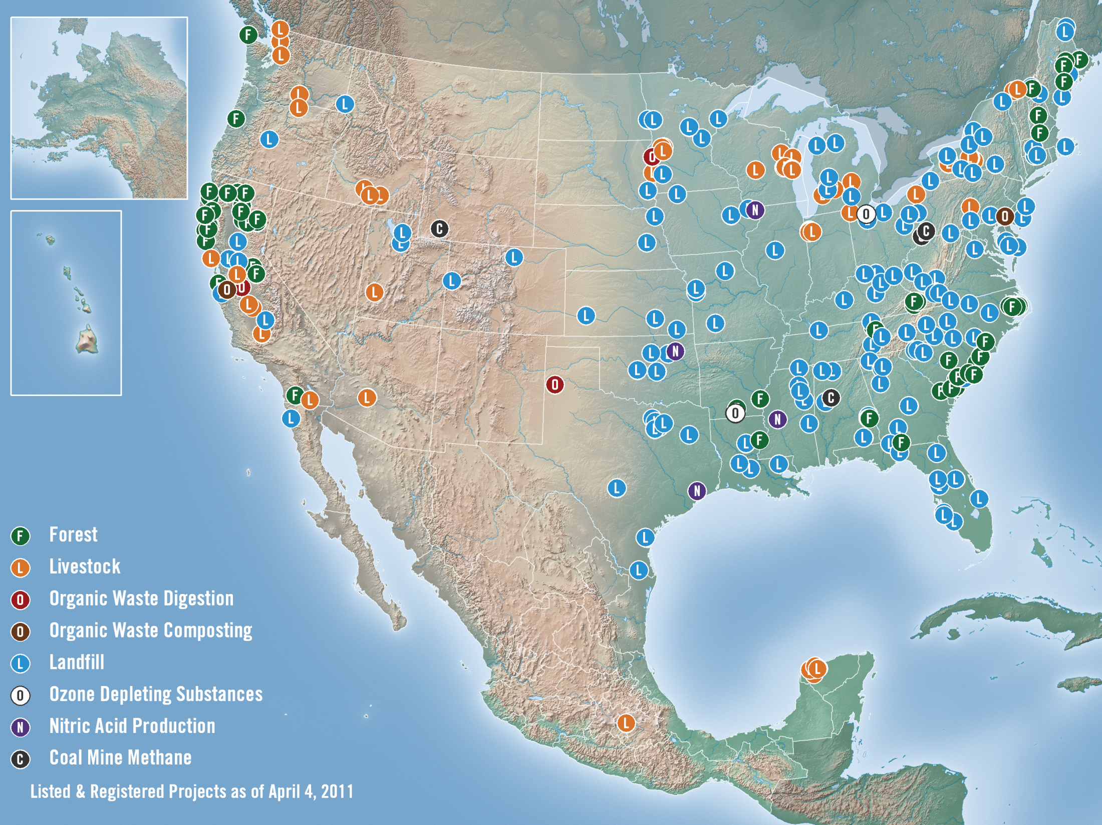

Slide 11
Reserve stats
CRTs registered | 13.1 million
CRTs retired | 2.0 million (15%)
Account holders | 380
Projects submitted | 415
Registered | 101
U.S. States with Projects | 44
Recent prices | ~$6-8 per CRT for ARB-approved protocols ~$3-4 per CRT for other protocols

Slide 12
Our Protocols
Developed with broad public input
Goal is to create a uniform standard that is widely recognized and builds on best practice
We incorporate the best elements of other protocols
We do not adopt protocols from other programs (i.e. CDM, Gold Standard, VCS, etc.)
Designed as step-by-step instructions on project development

Slide 13
Existing Protocols
Forestry
Urban forestry
Livestock methane capture (US & Mexico)
Ozone Depleting Substances (US & Article 5 sources)
Landfill gas capture (US & Mexico)
Organic waste digestion
Coal mine methane
Nitric Acid Production
Organic Waste Composting

Slide 14
Protocols In Progress
Forestry in Mexico
Agriculture
Rice Cultivation
Cropland Management
Nutrient Management

Slide 15
Compliance Protocols
Forestry: biological sequestration in forests for 100 years
Improved Forest Management
Reforestation
Avoided Conversion
Urban Forestry: sequestration in urban tree plantings for 100 years
Livestock: capture and destruction of methane from manure using anaerobic digestion
ODS: destruction of potent GHGs from appliances and foams from U.S. sources

Slide 16
Verification
Verification bodies (VBs) must get accredited to ISO standards by American National Standards Institute (ANSI)
Lead Verifiers must take protocol-specific and general Reserve training
VB submits NOVA/COI form and receives approval from Reserve to proceed
Developer hires accredited and trained VB
VB makes determination as to the accuracy of reported CRTs
Project documents, verification report and verification opinion submitted to the Reserve

Slide 17
Buying & Selling CRTs
Must have an account with the Reserve to hold CRTs
No financial transactions within the system, only CRT transfers
No trading exchange for spot transactions
Forward sales are very common
How to trade?
Purchase directly from a project developer
Purchase through a Trader/Broker/Retailer
Purchase futures on an exchange

Slide 18
Fee Structure
Account Maintenance: $500/year
Project Listing: $500/project
CRT Issuance: $0.20/tonne
CRT Transfer: $0.03/tonne
Retirement: Free

Slide 19
Cap-and-Trade in California
AB32 passed in 2006, cap-and-trade regulation adopted in Dec 2010
Begins Jan 1, 2012 and runs through 2020
Divided into three compliance periods of 3 yrs each
Narrow scope for 1st period, broad scope beginning Jan 1, 2015
Must have compliance instruments equal to your emissions for each year
Allowances: most allocated at the beginning, but auctioned in future years
Offsets: can be used for up to 8% of your compliance obligation

Slide 20
Offsets for Compliance
Up to 8% of your compliance obligation
Example: If your emissions are 1 million mtCO₂e, then you can use up to 80,000 offsets for that period
Two types of offsets, functionally equivalent
Early-Action Offsets
ARB Compliance Offsets
Four Climate Action Reserve project protocols have been adopted already
The Reserve will be applying to become an approved offset registry through ARB

Slide 21
ARB Next Steps
There are still many unknowns that are being finalized
Process for accrediting registries and verifiers is still unclear
ARB staff are continuing to update the regulation this year, revisions expected to be released in coming weeks and adopted by October 2011
Adopt additional offset protocols
Public workshops expected later this year

Slide 22
Contact Information
Joel Levin
jlevin@climateactionreserve.org
213.891.6927
www.climateactionreserve.org
523 W. 6th Street, Ste. 428
Los Angeles, CA 90014
213-891-1444

