Slide 1

Livestock methane carbon offsets
Creating value from a bunch of manure
Peter Freed, Director, TerraPass 6/21/2011

Slide 2
Who is TerraPass?

Slide 3
What makes a livestock project?

Slide 4
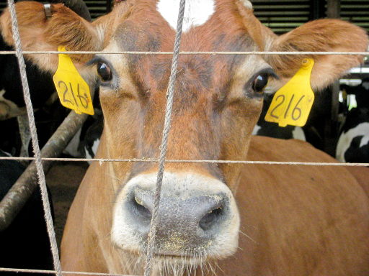
Carbon offsets all start here

Slide 5
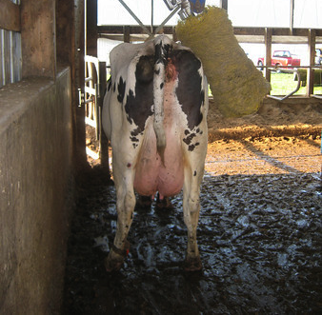
Well, actually…

Slide 6
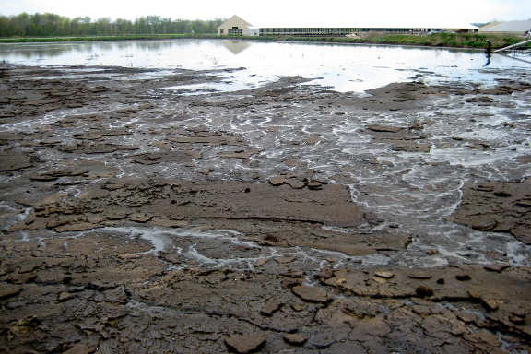
This gives us a “baseline”

Slide 7
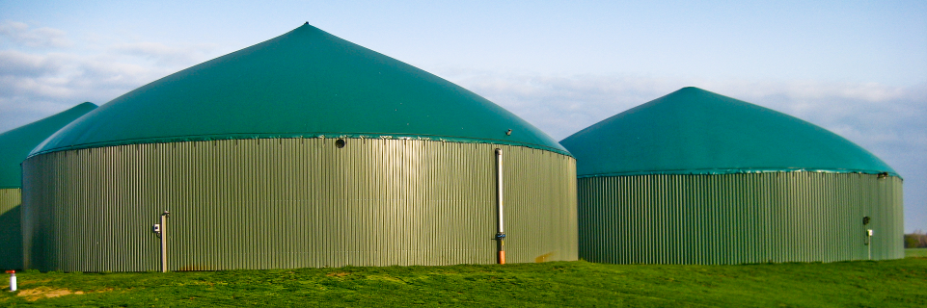
And allows us to have a project

Slide 8
What projects are eligible?*
*According to CAR LPP v3.0

Slide 9
Dairy and Swine

Slide 10
Location

Slide 11
Start Date

Slide 12
Liquid baseline

Slide 13
Additonal

Slide 14
Meets all applicable laws

Slide 15
ER = BE - PE

Slide 16
What makes a high-quality project?*
*Depends who you are

Slide 17
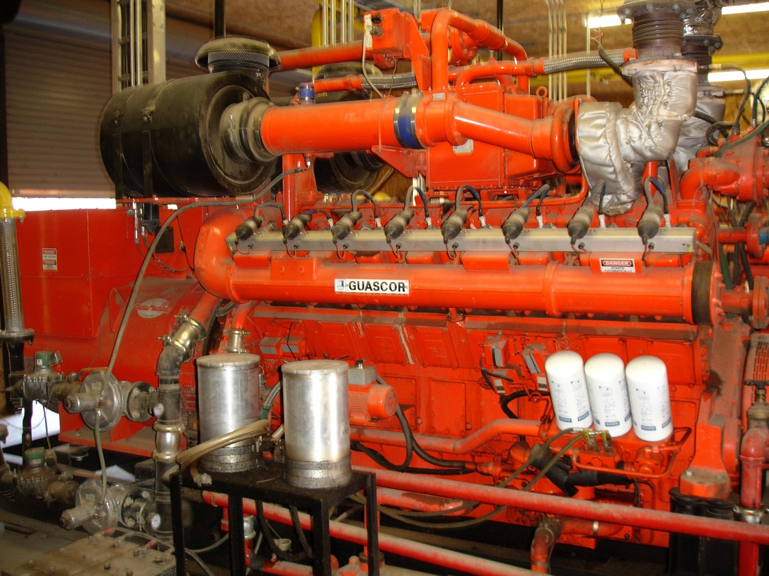
George DeRuyter and Sons Dairy
Real

Slide 18
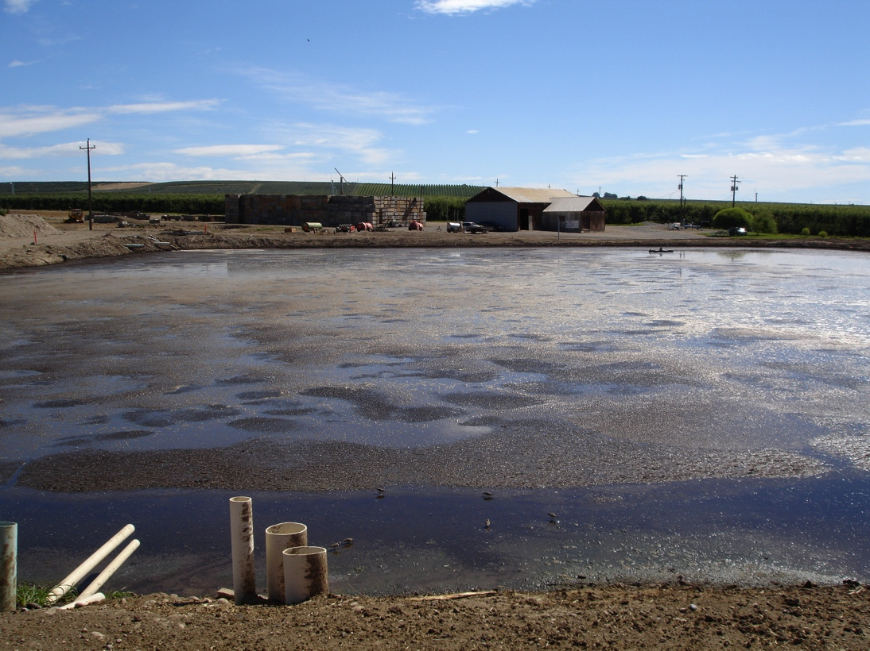
Additional

Slide 19
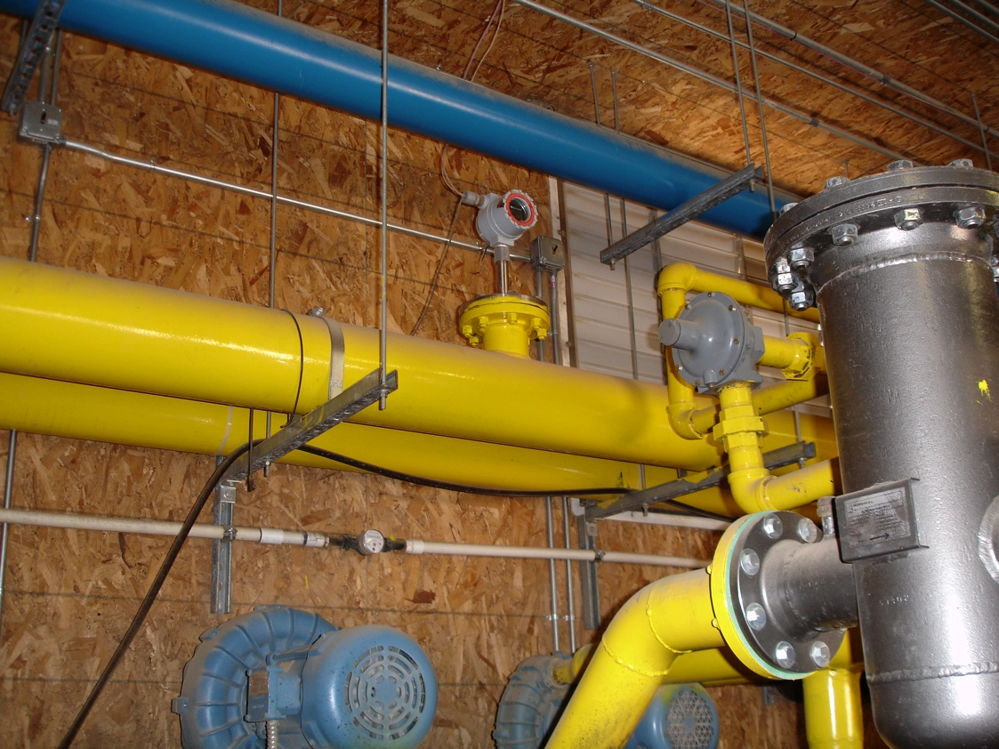
Verifiable

Slide 20
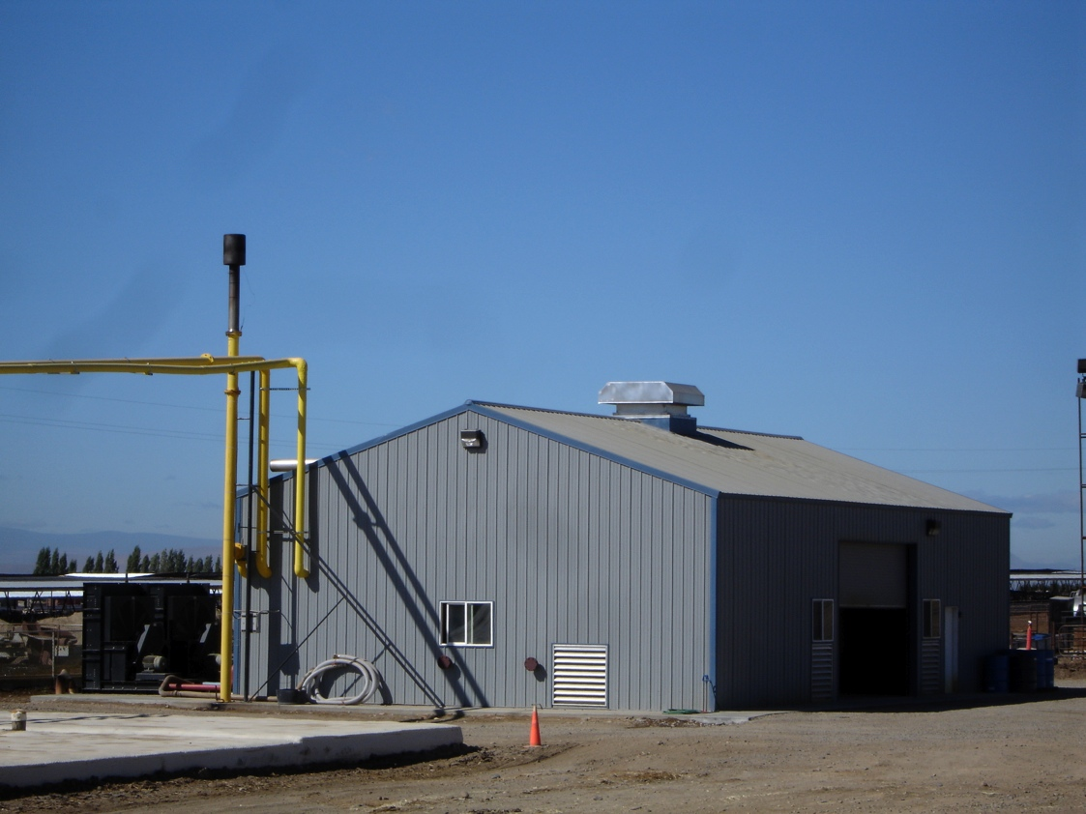
Permanent

Slide 21
What’s the story with the ARB livestock haircut?

Slide 22
Thanks!

