Slide 1
California Offsets Workshop Current State of the California Carbon Market August 8, 2011 Josh Margolis jmargolis@cantorco2e.com 415-296-9359

Slide 2
Agenda
Who are these guys? CantorCO2e
Litigation Sound and fury signifying?
Market mechanics what, when, how
Market size $3 - $128 billion
Allowances & offsets $6 - $80
Transaction types spot, stream, options, hedge
Market color its complicated
Actions to take now comment, assess, hedge

Slide 3
Who is CantorCO2e?
California roots
Since 1992 (and before) Auction agreements with >300 companies
Most credits brokered Los Angeles
CEC Climate Change Advisory Comm San Francisco
Brokerage, strategy, advisory, marketing, and regulatory assistance
Subsidiary of Cantor Fitzgerald, global financial services firm
> $10 billion environmental & energy transactions
CARB CRTs & CAs SO2 EAs NOx SIP Call ERC
GHG VERs RECLAIM HGA DERs
RGGI RECs/ROCS Biomass VERs
CERs EU EAs Wastewater
VCUs ATUs
Helping companies develop and implement
successful offset/carbon management strategies
Environment
Markets
Compliance
Voluntary
Innovation
Finance
Securitization
Technology
Energy
Renewables

Slide 4
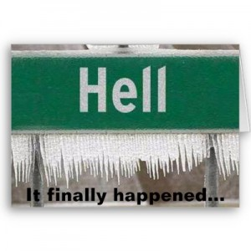
Litigation from Market’s Perspective
Key dates
Roller coaster
what’s EJ got to do with it?
it’s all over what? we agree with them?!?
just show your homework
the sun’s coming up tomorrow
the other shoe
Betting on:
program - what’s creditable
start date - next lawsuit
Just give me certainty
Prohibition on speculation

Slide 5
Potential Value of Traded* Credits
Allowances | 2,186,079,000 |  | 2,336,957,000
Auction | % Auctioned (est) |  | Unit Price (est) |  | Total Value
Low (est) | 5% |  | $10 |  | $1,093,039,500
High (est) | 60% |  | $70 |  | $91,815,318,000
Offsets | 200,688,000 |  | 213,952,000
 | Unit Price (est) |  | x Sold (est) |  | Total Value
Low (est) | $10 |  | 1 |  | $2,006,880,000
High (est) | $70 |  | 4 |  | $56,192,640,000
Total Est Value of Allowances & Offsets
 |  |  |  | Low | $3,099,919,500
 |  |  |  | High | $148,007,958,000
* Excludes value of freely allocated emission allowances
Notes:
Rule does not preempt states from regulating or requiring reporting of GHGs
• No state delegation
• Reporting entities will report directly to EPA

Slide 6
Pre-June 29th
Post-June 29th
Allowances: 2,336,957,000 2,186,079,000
Offsets: 213,952,000 200,688,000
Reserve: 123,491,000 121,833,000
Allowances: 2,336,957,000
Offsets: 213,952,000
Reserve: 123,491,000
1
2
3

Slide 7
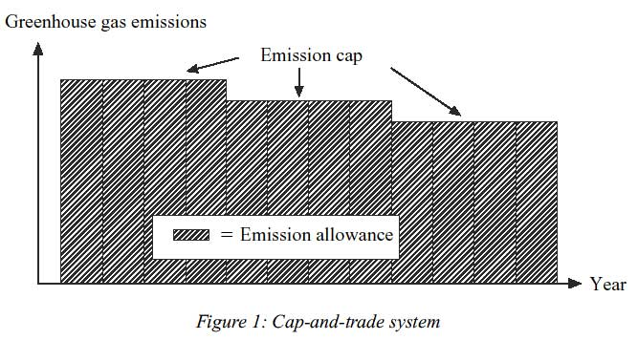
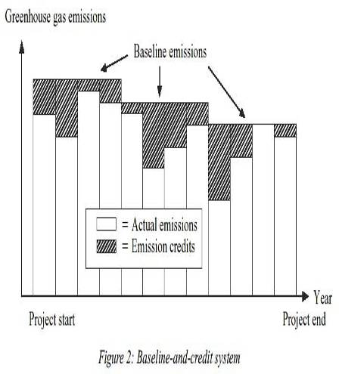
Declining Emissions Checkbook

Slide 8
Market Participants
What | Who | Concerns
Compliance Buyers | Utilities/Power Investor owned Publically owned Independent power producer | Speculation? Must sell 100% at auction May keep allocations 100% short
 | Industrials (who gets what?) | Benchmarking (trench warfare)
 | CEQA | Criteria Double dip demand
Financials | Funds Commodity trading shops/banks | Oversight
Brokers | Such as CantorCO2e | Oversight
Exchanges | Green Ex, ICE, Pacific Carbon Ex, Others
Auction Houses | Exchanges? | August 2012, quarterly, rules

Slide 9
Transaction Types
Auctions
Spot
Stream
Swaps
Options
Firm delivery
Unit contingent
Guaranteed CARB
Offsets
Allowances

Slide 10
Transaction Types
Spot Transaction
Verified, issued offsets or allowances
Pros: POD, low quantity/delivery risk, seamless transaction
Cons: Some buyers looking for future vintages
Stream Transaction
Multiple years of created, prospective offsets/EAs
Pros: Lock in future year price, establish cash flow/cost
Cons: Locked price reduces ability to transact at better price
Hedge: Structure a floor/ceiling profit share

Slide 11
Transaction Types
Firm Delivery
Supplier guarantees delivery at set date/price
Pros Higher price
Cons Penalties for non-delivery, credit?
Unit Contingent
Delivery of credits when/if issued
Pros No non-delivery penalty if not issued
Cons Likely to be priced lower

Slide 12
Transaction Types
Swaps
Non cash transaction
Options
Risk management
Right, not obligation
Calls right to buy at set level over set term
Puts right to sell at set level over set term

Slide 13
Transaction Types
Guaranteed CARB Offset or Allowance
Terms
Program in force
Dec 12, 13, 14 (one year delay)
Allowances/offsets issued/blessed by CARB
Issues
Credit
Policy/legal

Slide 14
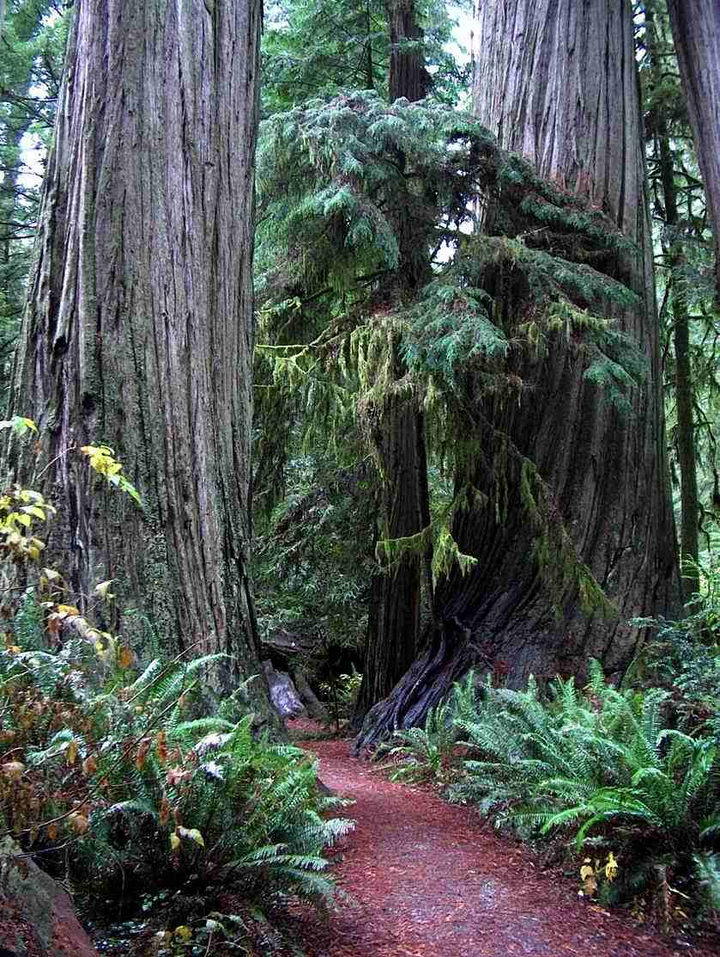
Offsets
200+ MMTCO2e through 2020 limit
8% of compliance obligation
Location – CA, North America… for now
ARB Protocols
Forestry protocol v 2.1, 3.0-3.2
Urban forests protocol v 1.0-1.1 ???
US ODS protocol v 1.0
Livestock manure protocol v 1-3
Notes:
Rule does not preempt states from regulating or requiring reporting of GHGs
• No state delegation
• Reporting entities will report directly to EPA

Slide 15
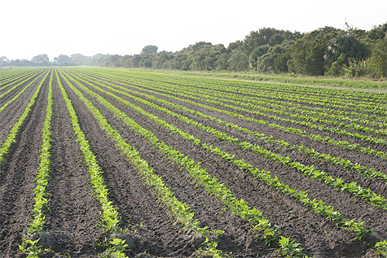
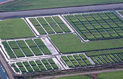
Potential Offsets
What’s next (maybe?)
CAR Ag
Cropland Management
Nutrient Management
Rice Cultivation
VCS REDD
CAR Nitric Acid
CAR Mexico Livestock
LFG?
Notes:
Rule does not preempt states from regulating or requiring reporting of GHGs
• No state delegation
• Reporting entities will report directly to EPA

Slide 16
Allowances vs Offsets
 | Allowances | Offsets
Available from CARB | Yes | No
Third Party Market | Yes* | Yes
Available Outside Auctions | Yes | Yes
Holding Limit | Yes | No
Price Limits | Yes | No
Forward Buys | Limited | Yes
Charismatic (Carbon with a Story) | No | Yes
Risk of Reversal | No* | Yes
Due Diligence Importance | No | Very

Slide 17
Price Indications
Recent Bid/Ask for Carbon Instruments (8/8/11)
Product | Type | Quantity | Vintage | Bid/Ask
CAR | Forestry 2.1 | 25,000 | 2012 | 6.75/8.00
CAR | Forestry 3.1 | 25,000 | 2005-12 | 6.75/8.00
CAR – Dom | ODS - Domestic | 25,000 | 2010-2011 | 8.75/10.00
CAR | Ag Methane | 20,000 | 2010-13 | 8.75/9.75
CAR | LFG | 25,000 | 2008 -2011 | 2.00/3.00
CAR | ODS – Article V | 25,000 | >2005 | 1.50/4.00
CAR | N2O | 100,000 | >2005 | 1.50/3.50
CCO | Offset | 25,000 | - | 11.00/12.50
CCA Forward DEC-12 | Allowance | 25,000 | - | 14.75/16.00
CCA Forward DEC-13 | Allowance | 25,000 | - | 15.75/16.50

Slide 18
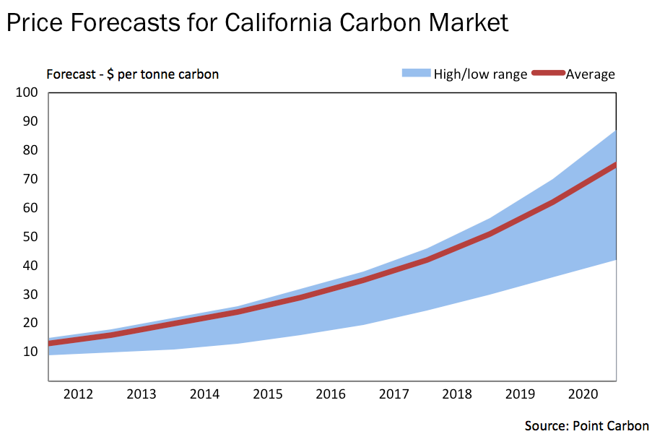
Price Indications
CCA/CCO Bid Ask*
Offset Bid Ask*
Source: Reuters graphic/Stephen Culp via Point Carbon
** CCA/CCO/Offsets quotes through 2013

Slide 19
Actions to Take Now
Comment on CARB rules
Quantify current and expected 13 – 20 emissions
AB32, CEQA, voluntary
Build portfolio of solutions
Onsite controls, efficiency improvements, biomass
Identify control cost curve
Managing carbon liabilities
Create CARB offsets if possible
Define and resolve expected net short position
Participate in 3rd party projects
Offset due diligence (reversals, delivery, PR risk)
Comment on CARB rules (8/11)
Notes:
Rule does not preempt states from regulating or requiring reporting of GHGs
• No state delegation
• Reporting entities will report directly to EPA

Slide 20
Speaking of Rules . . .
Eliminate buyer liability
100% shortage in allocation for IPPs
Increase 8% offset limit
Allow forward carry of unused offset capacity
Increase offset classes and volumes
Issue multi-year allocations
DEADLINE: 8/11/11 http://is.gd/mJuWjl
Notes:
Rule does not preempt states from regulating or requiring reporting of GHGs
• No state delegation
• Reporting entities will report directly to EPA

Slide 21
Thank You
Josh Margolis
415.296.9359
jmargolis@cantorco2e.com
www.emissionstrading.com

